Slide 1



A DISTRIBUTOR SELLING ELECTRONICS DEVICES PRODUCTS
Bùi Hữu Lộc

Slide 2
Introduction

Slide 3
Business Requirement

Slide 4
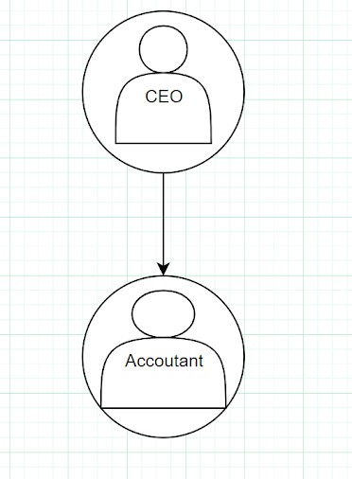
Organization Chart

Slide 5
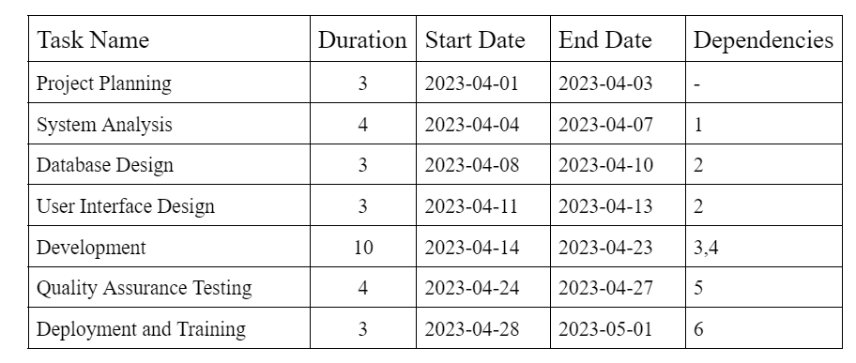
Project Chart

Slide 6
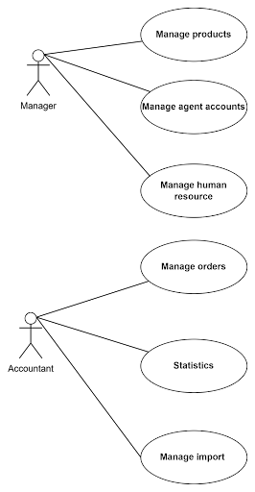
Business Modelling/Requirements

Slide 7
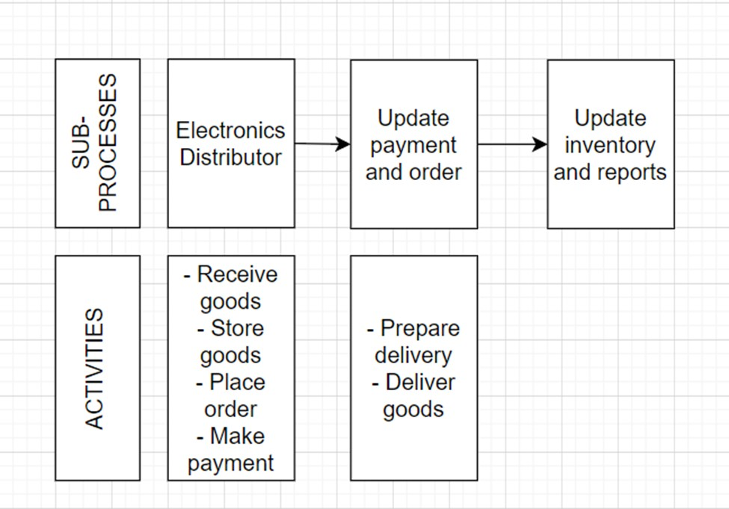
Business Processes / Flowchart of Requirements

Slide 8
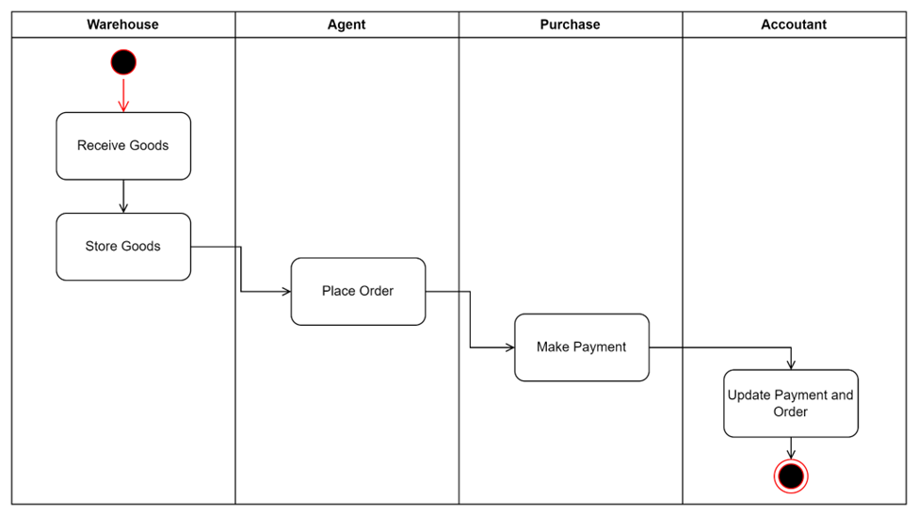
Activity Diagram

Slide 9

System Requirements Analysis

Slide 10
Translate from Business Use Case
1
2
3
System Narrative
Users and their goals
Actors

Slide 11
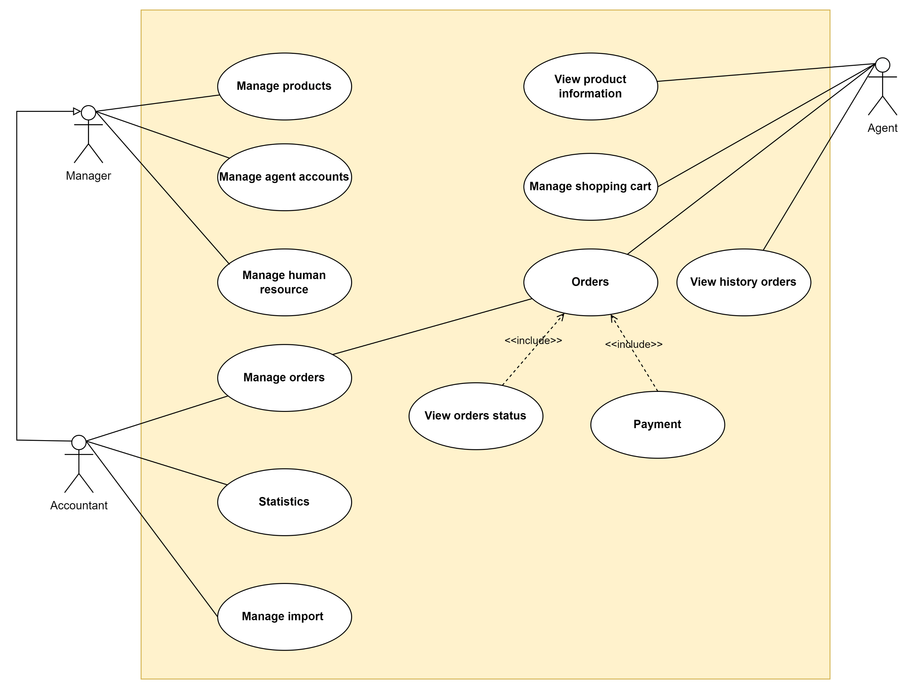
Usecase diagram

Slide 12
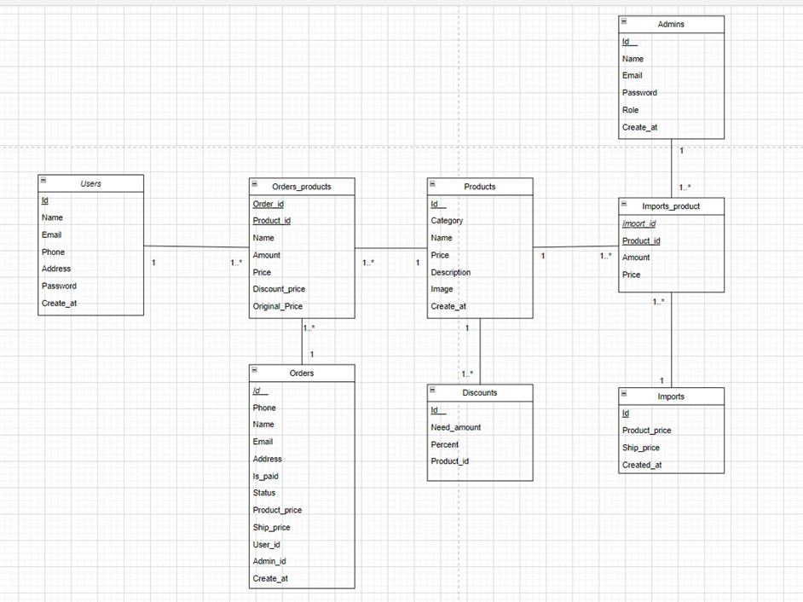
Domain Class Model Diagram

Slide 13
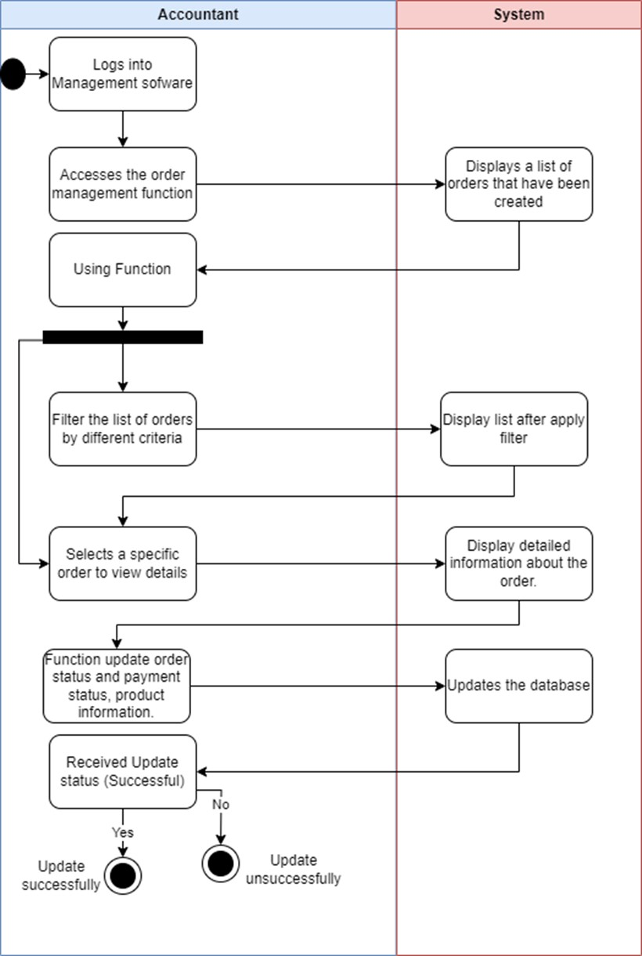
Usecase Manage Order Activity diagram

Slide 14
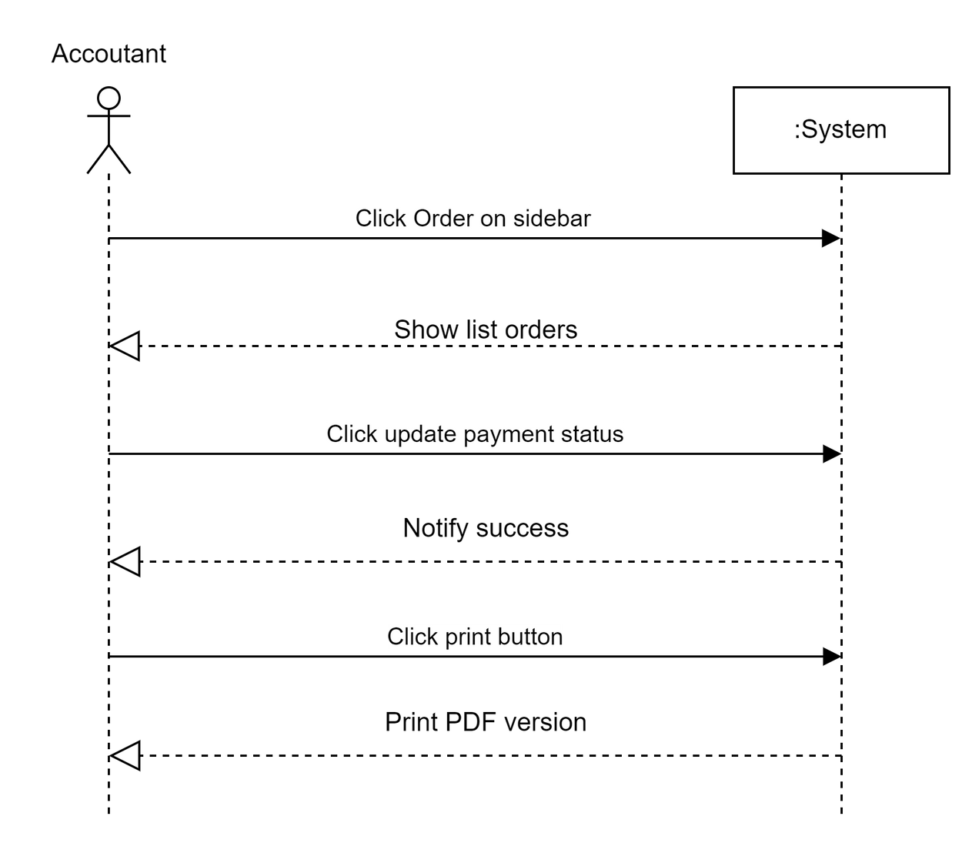
Usecase Manage Order System sequence diagram
=

Slide 15
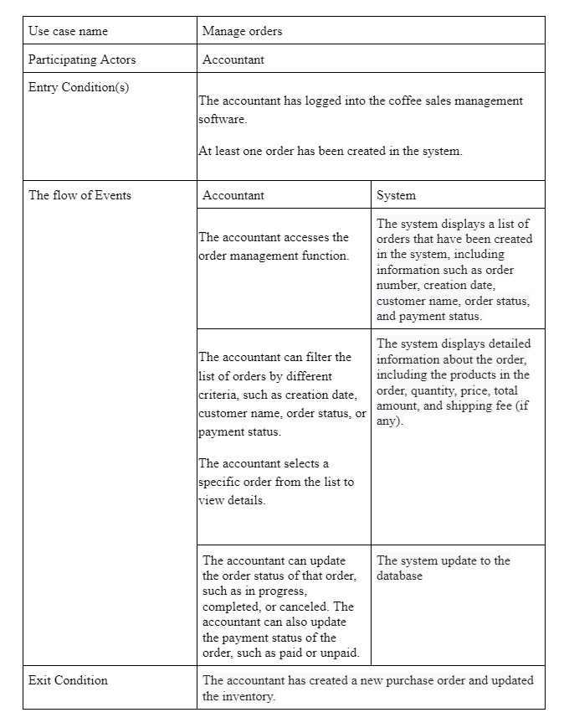
Usecase Manage Order Usecase Description
=

Slide 16
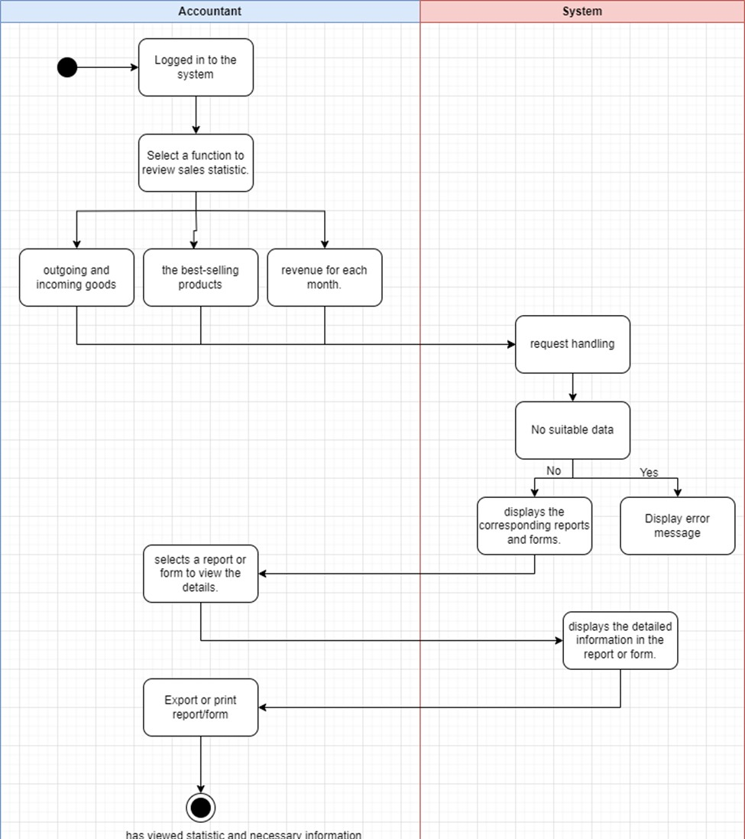
Usecase Statistic Activity diagram

Slide 17

Usecase Statistic
System sequence diagram

Slide 18
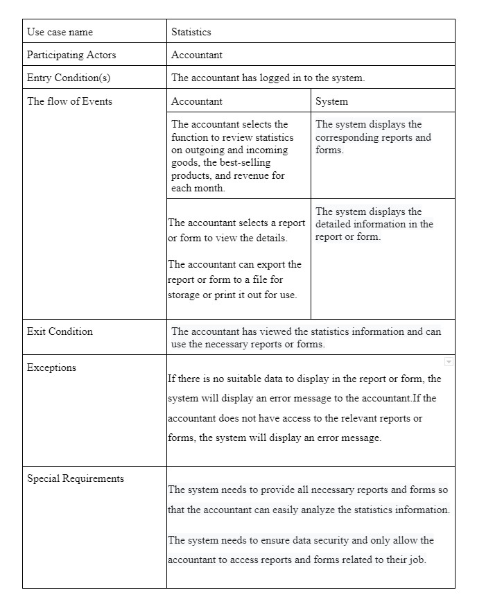
Usecase Statistic Usecase Description

Slide 19
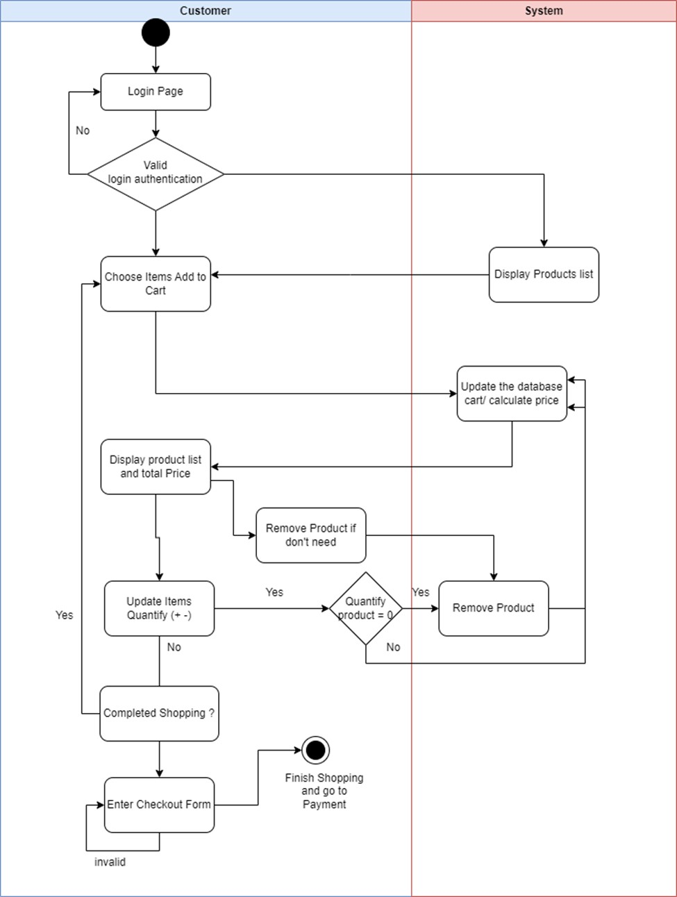
Usecase manage shopping cart Activity diagram

Slide 20
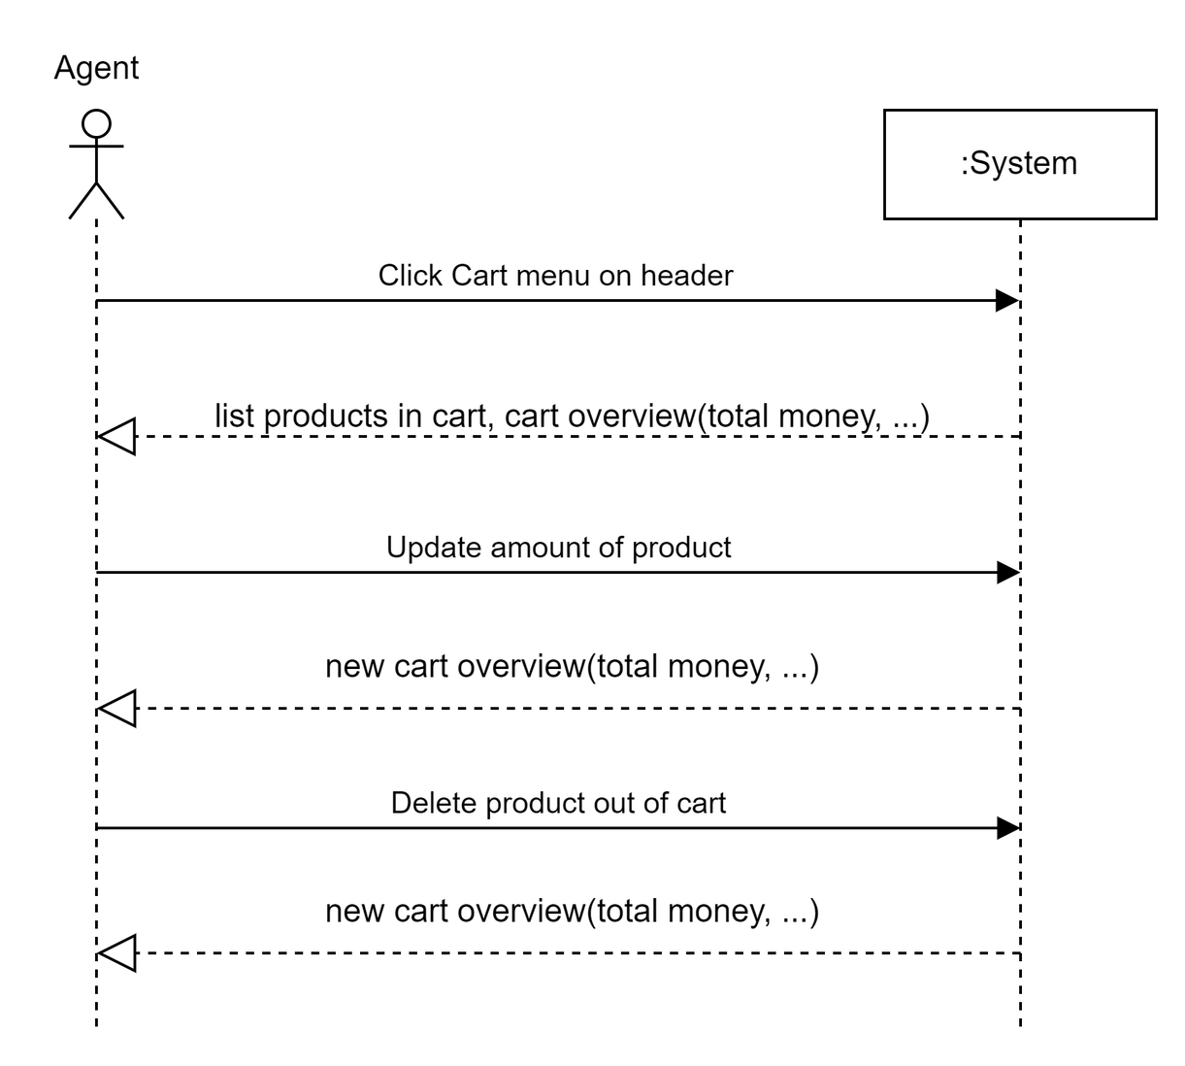
Usecase manage shopping cart System sequence diagram

Slide 21
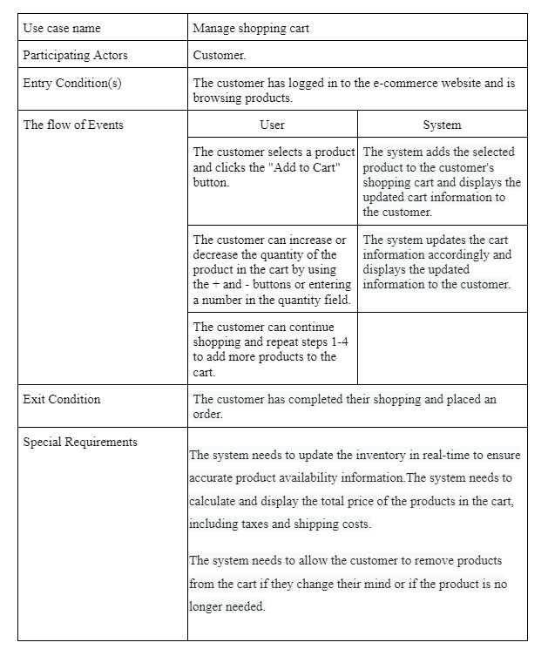
Usecase
manage shopping cart Usecase description

Slide 22
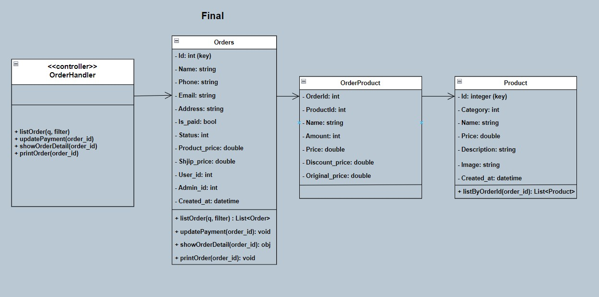
Design Class Diagram Use Case Manage Order
=

Slide 23
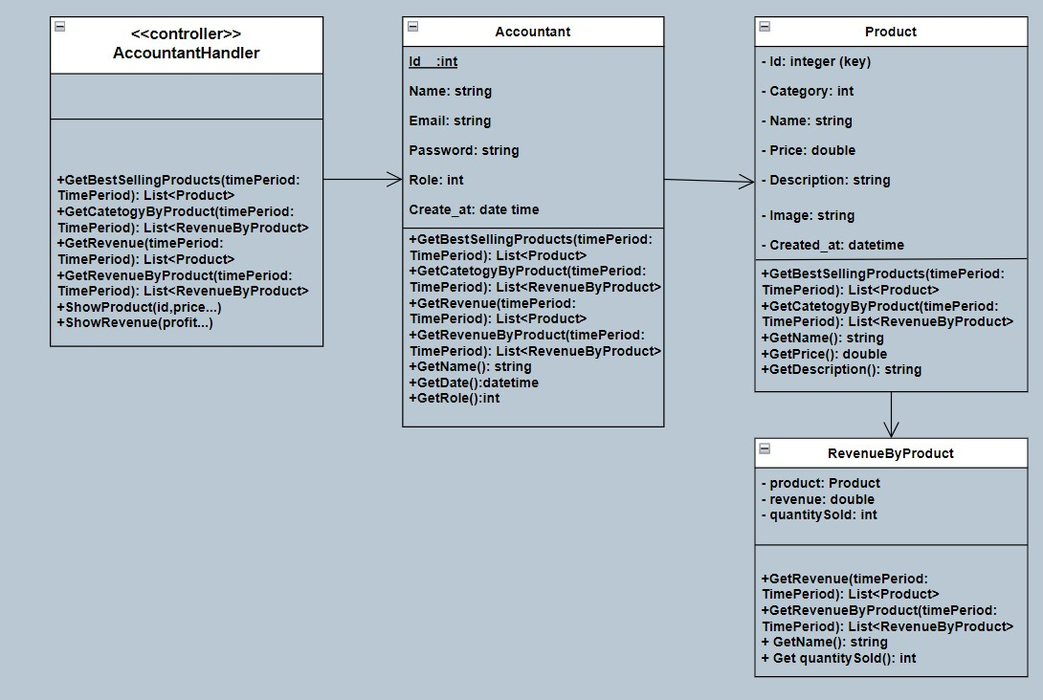
Design Class Diagram Use Case Statistic
=

Slide 24
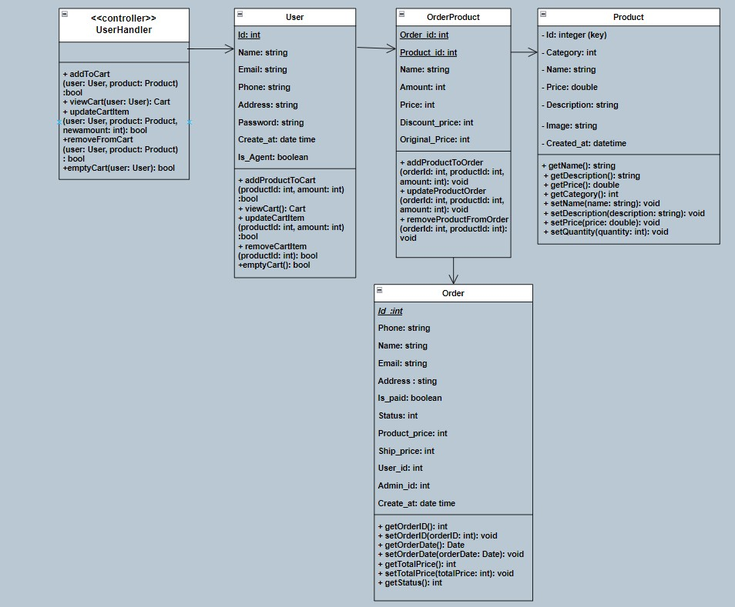
Design Class Diagram
Use Case Manage Shopping Cart
=

Slide 25
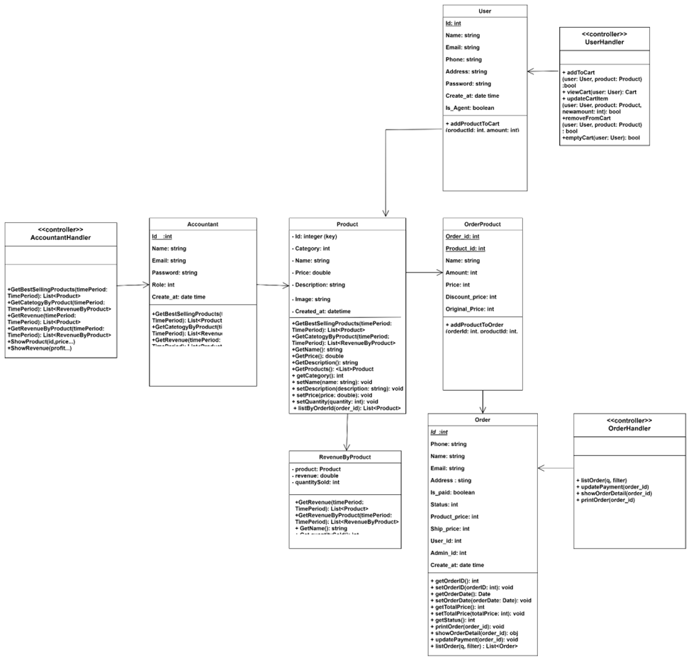
Design Class for Sub System
=

Slide 26
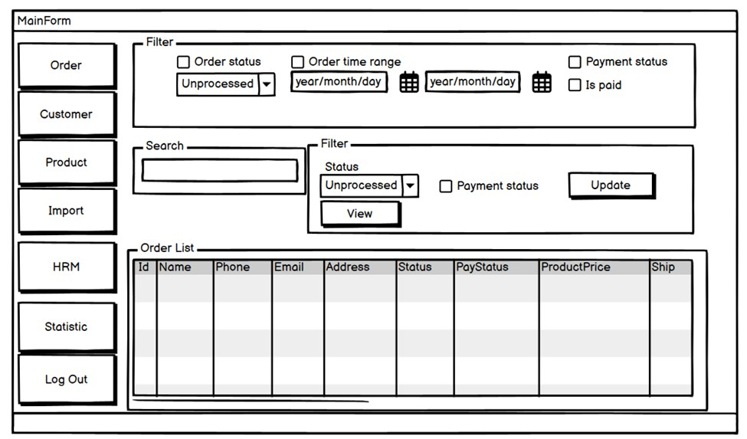
UI Usecase Manage Order

Slide 27
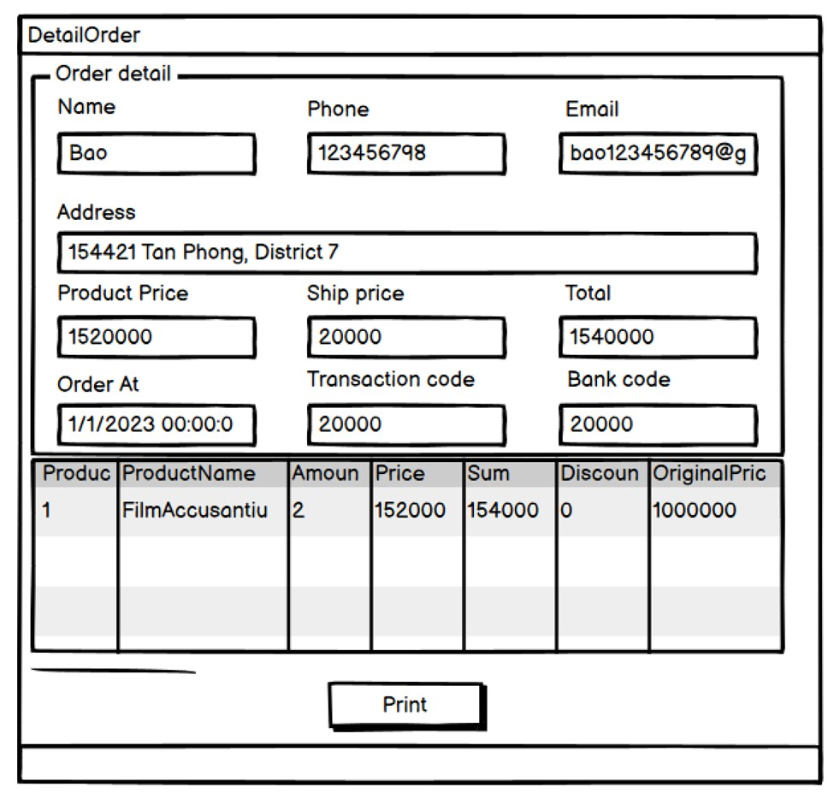
UI Usecase Manage Order

Slide 28
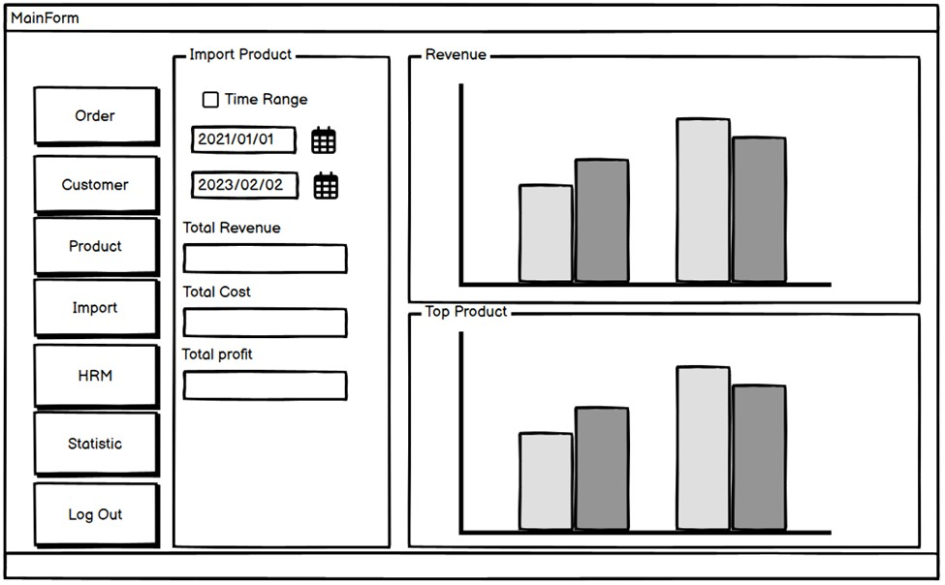
UI Usecase Statistic

Slide 29
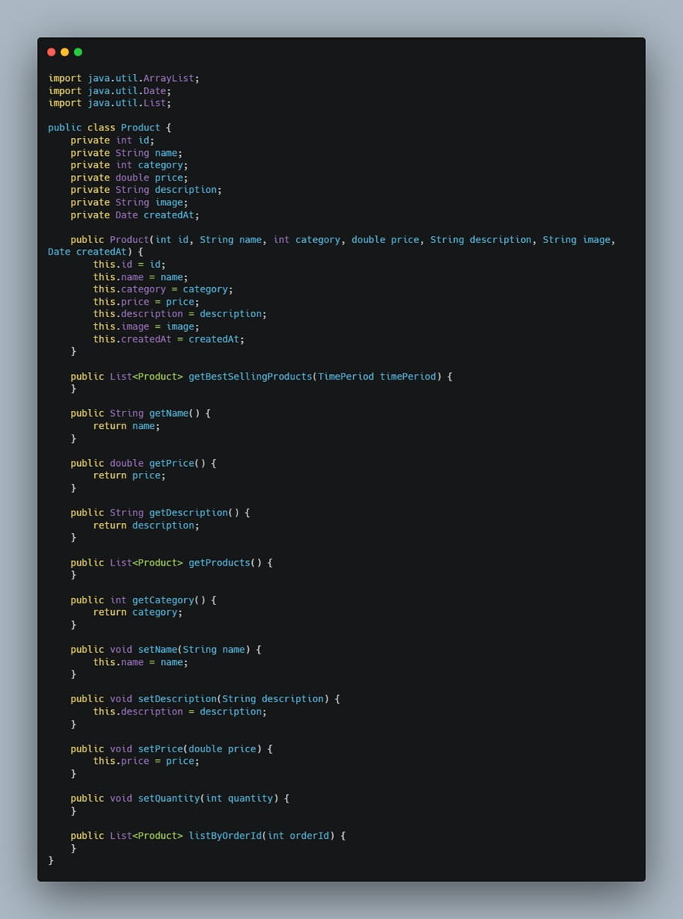
Class Method Code Product

Slide 30
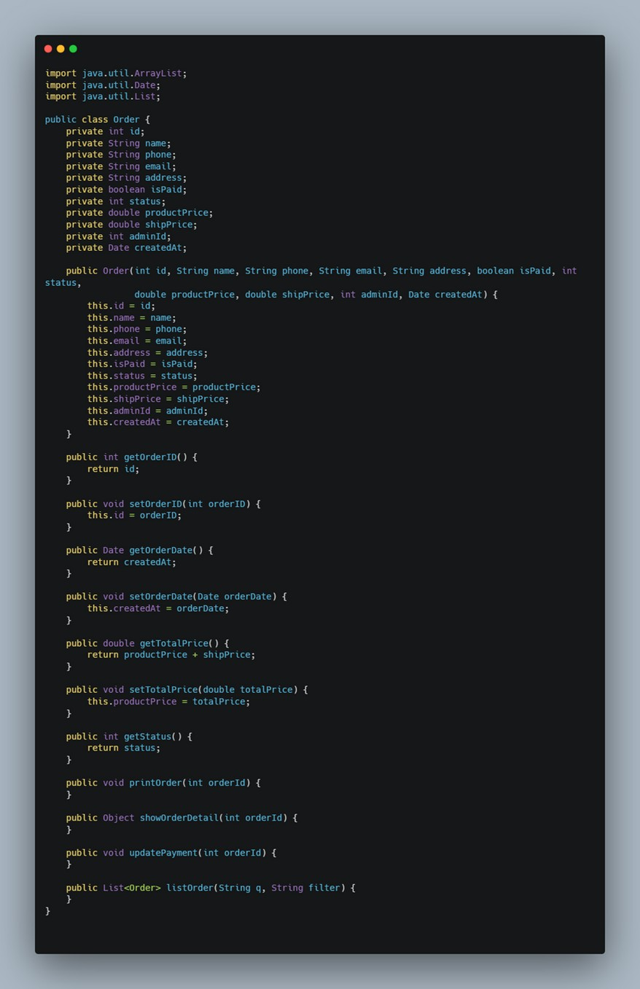
Class Method Code Order

Slide 31
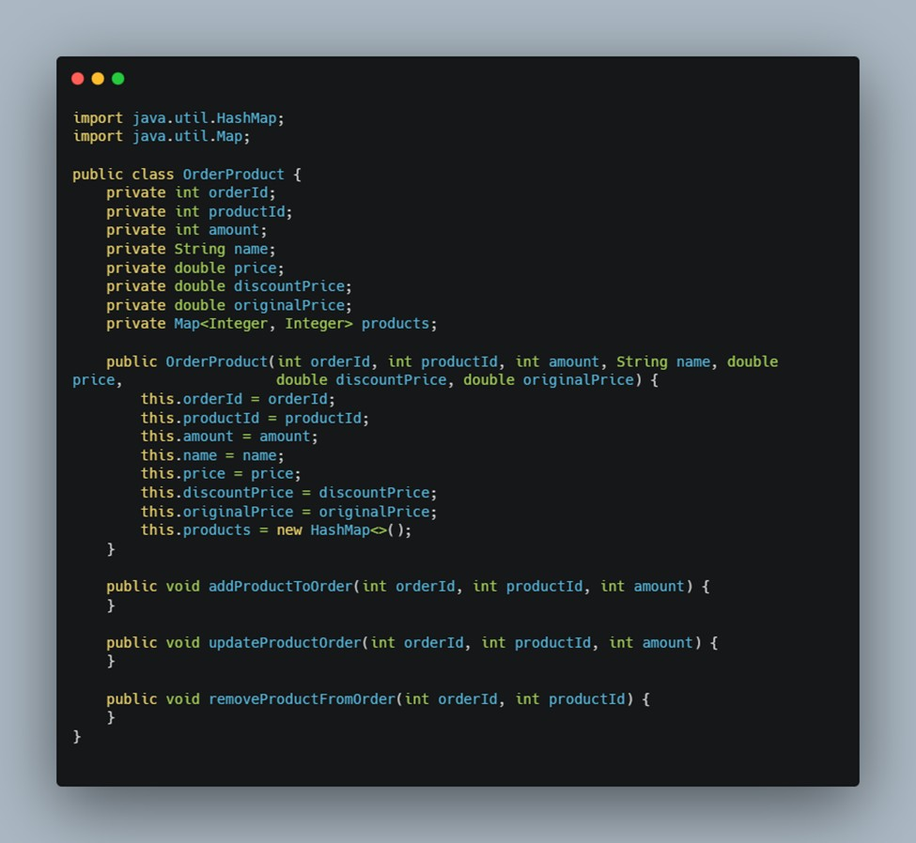
Class Method Code OrderProduct

Slide 32
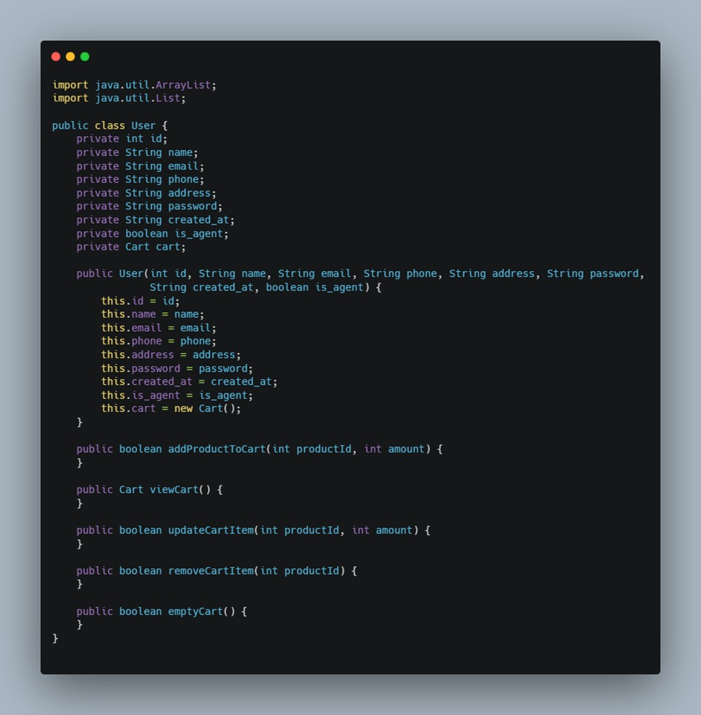
Class Method Code User

Slide 33
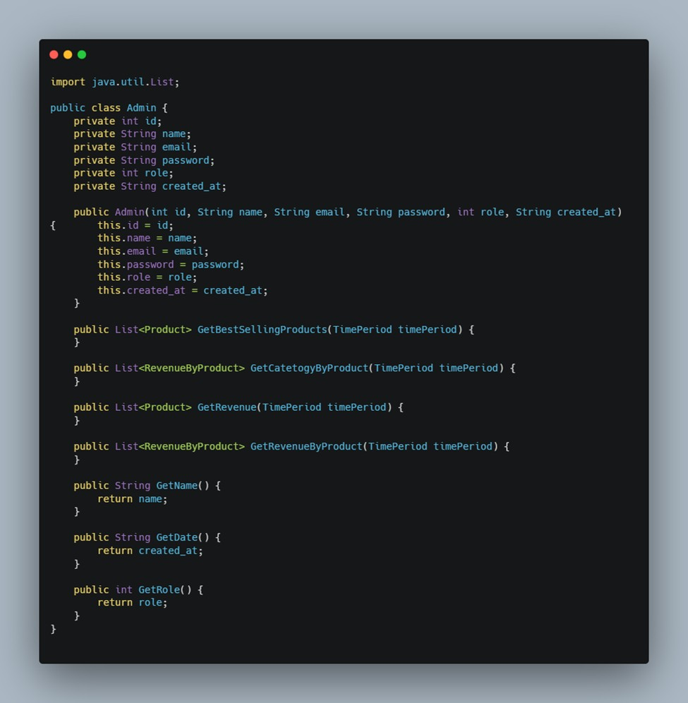
Class Method Code Admin

Slide 34
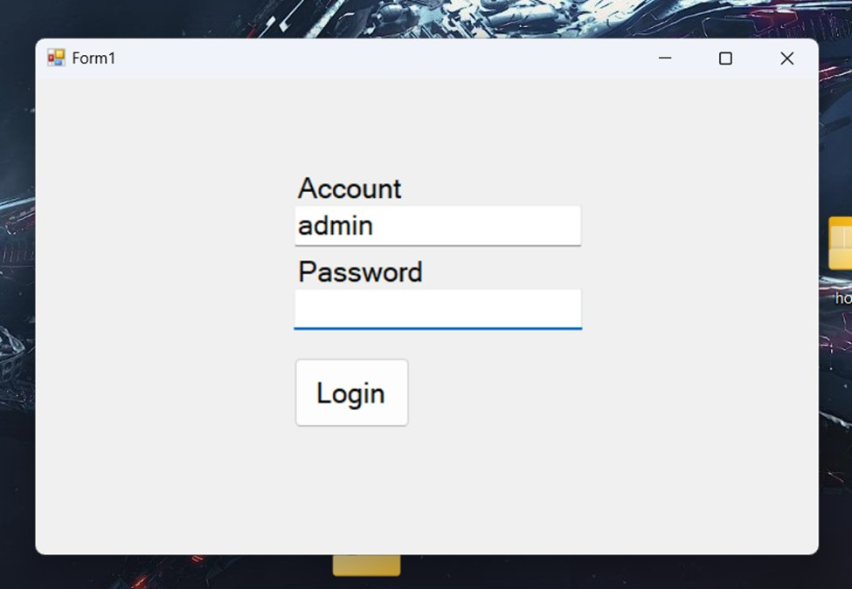
Demonstration Login

Slide 35
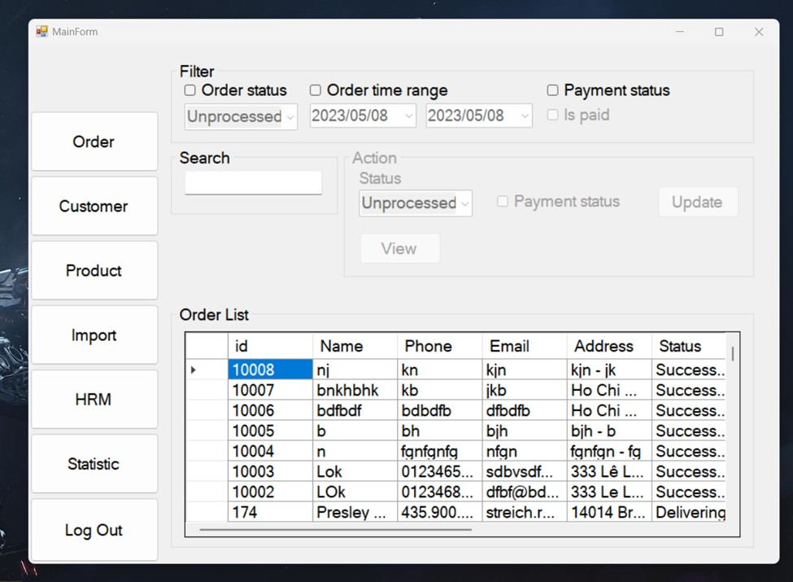
Demonstration Manage Order

Slide 36
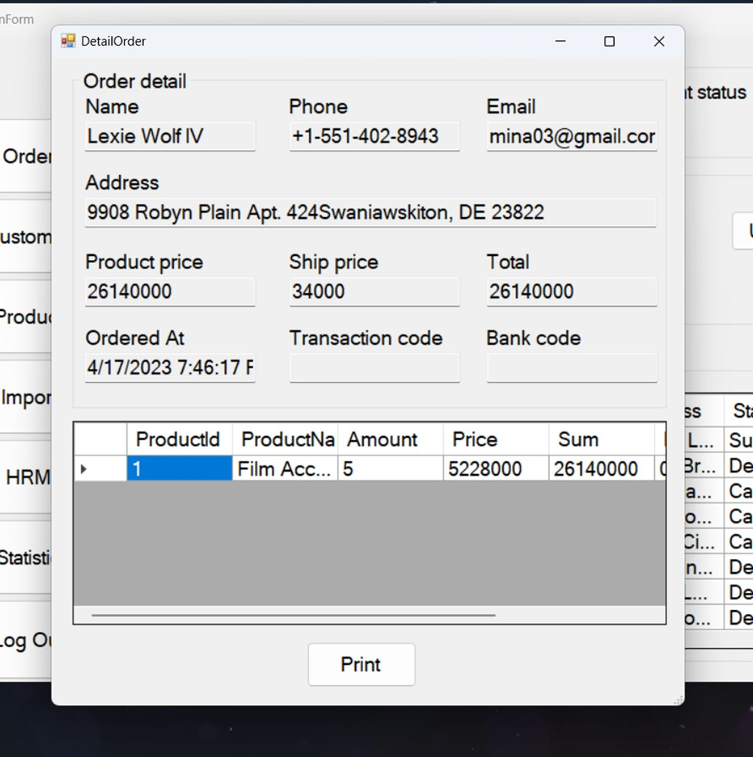
Demonstration Detail Order

Slide 37
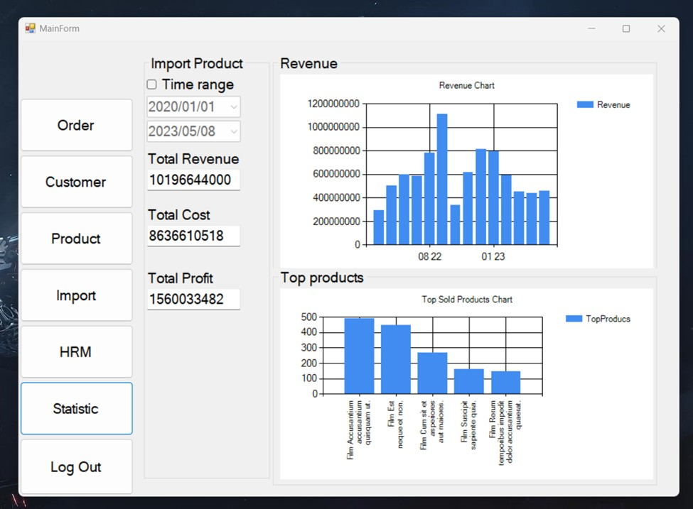
Demonstration Statistic

Slide 38




Thank you

